Slide 1
MALLA REDDY UNIVERSITY
MR22-1CS0141:
DESIGN AND ANALYSIS OF ALGORITHMS
II YEAR B.TECH. (CSE) / I - SEM
(MRU - R22)
UNIT-II

Slide 2
UNIT- II
Disjoint set operations: Disjoint set data structure, Simple algorithm for Union and Find, Collapsing rule for Find, Representation of Disjoint sets using Arrays, Connected components, Articulation point, Finding articulation points, Bi-connected components.
Backtracking- General method of Backtracking, Applications of Backtracking - The N-queen problem, Sum of subset problem, Graph coloring by backtracking, Hamiltonian cycles problem.

Slide 3
Set & Disjoint set
Set:
A set is a collection of distinct elements. The set can be represented, for example, as S={A,B,C,D,E} .
Disjoint sets:
The disjoint sets are those that do not have any common element.
For example,
S1={A,C,D,E} and
S2={B,F,G},
then we can say that S1 and S2 are two disjoint sets.

Slide 4
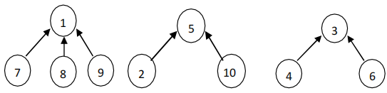
Set Representations
Two representations are,
Tree representation
Array representation
Tree Representation:
All the children will store the address of parent / root node.
The root node will store negative value at the place of parent address.
From the given set of elements any element can be selected as the root node, generally we select the first node as the root node.
s1={1,7,8,9} s2={2,5,10} s3={3,4,6}

Slide 5
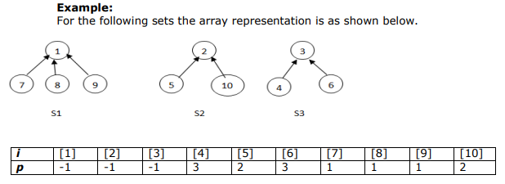
Set Representations
Array Representation:

Slide 6
Disjoint set operations
Disjoint set operations:
1. Union
2. Find
Disjoint Set union:
If Si and Sj are two disjoint sets, then their union Si U Sj contains all the elements x such that x is in Si or Sj.
Example:
S1={1,7,8,9} and S2={2,5,10}
Then, S1 U S2 ={1,7,8,9,2,5,10}
Find(i): Given the element i, find the set containing i.
Example:
S1={1,7,8,9} and S2={2,5,10}
Then, Find(5)= S2 Find(7)=S1

Slide 7
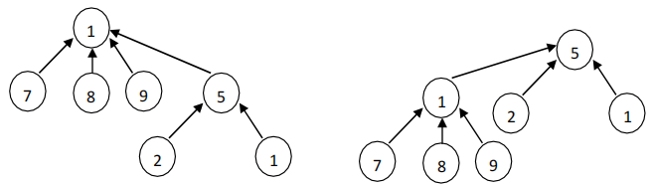
Disjoint Union
Union(i,j) requires two tree with roots i and j be joined. S1 U S2 is obtained by making any one of the sets as sub tree of other.
Example:

Slide 8
Simple Algorithm for Union
Algorithm Union(i,j)
{
P[i]:=j;
}
Example :
Implement following sequence of operations Union(3,1), Union(5,2), Union(2,1) and Union(1,2)
1
2
1
2
3
5
3
2
5
1
5
3

Slide 9
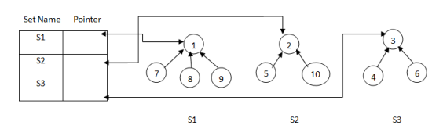
Find(i) operation
To perform find operation, along with the tree structure we need to maintain the name of each set.
we require one more data structure to store the set names.
The data structure contains two fields.
One is the set name and the other one is the pointer to root.

Slide 10
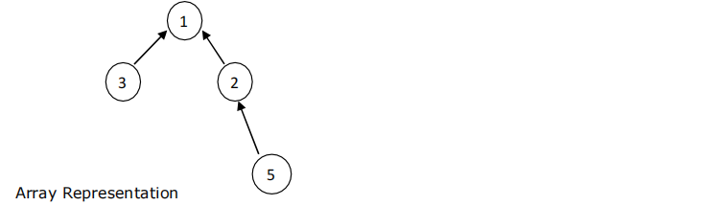
Example for Find(i)
Example:
Find(5)=1
Find(2)=1
Find(3)=1
The root node represents all the nodes in the tree.
i | 1 | 2 | 3 | 5
P[i] | -1 | 1 | 1 | 2

Slide 11
Simple Algorithm for Find(i)
Algorithm Find(i) // Determines the root of the tree containing element i.
{
while(p[i]>=0)
do i:=p[i];
return i;
}
i | 1 | 2 | 3 | 5
P[i] | -1 | 1 | 1 | 2

Slide 12
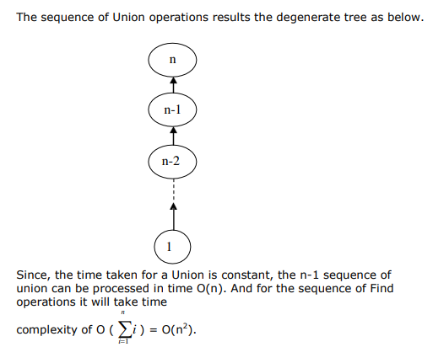
Analysis

Slide 13

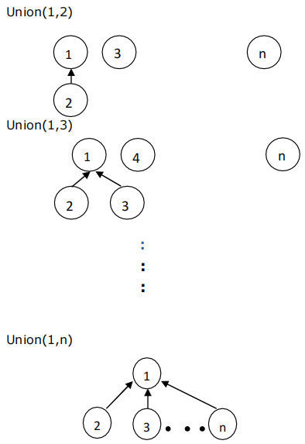
Weighting rule for Union(i,j)
Tree obtained with weighted Initially,

Slide 14
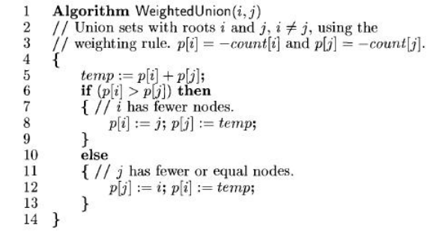
Weighting rule for Union(i,j)
To improve the performance of union and find algorithms by avoiding the creation of degenerate tree. To accomplish this, we use weighting rule for Union(i,j).
Weighting Rule for Union(i,j):

Slide 15
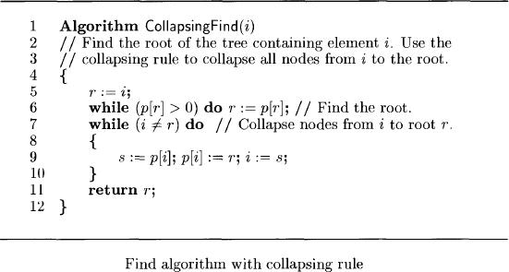
Collapsing rule for Find(i)

Slide 16
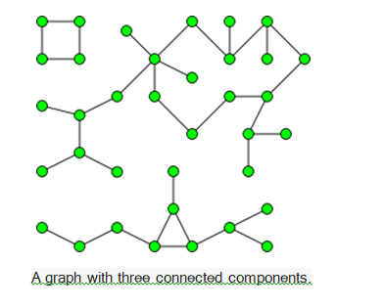
Connected components
A connected component of an undirected graph is a subgraph in which any two vertices are connected to each other by paths, and which is connected to no additional vertices in the super graph.
For example,
The graph shown in the illustration has three connected components.
A vertex with no incident edges is itself a connected component.
A graph that is itself connected has exactly one connected component, consisting of the whole graph.

Slide 17
Biconnected Components
Let G = (V, E) be a connected undirected graph.
Definitions:
Articulation Point (or Cut Vertex): An articulation point in a connected graph is a vertex (together with the removal of any incident edges) that, if deleted, would break the graph into two or more pieces..
Bridge: is an edge whose removal results in a disconnected graph.
Biconnected: A graph is biconnected if it contains no articulation points. In a biconnected graph, two distinct paths connect each pair of vertices. A graph that is not biconnected divides into biconnected components.

Slide 18
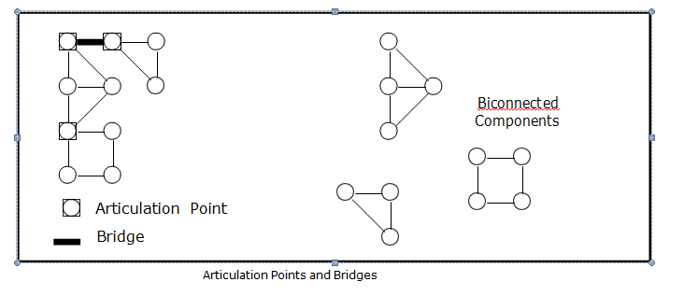
Biconnected Components

Slide 19
Biconnected Components
Let us consider the typical case of vertex v,
v is not a leaf
v is not the root.
Let w1, w2, . . . . . . . w_{k} be the children of v.
For each child there is a subtree of the DFS tree rooted at this child.
If for some child, there is no back edge going to a proper ancestor of v.
if we remove v, this subtree becomes disconnected from the rest of the graph,
Hence v is an articulation point.
L (u) = min {DFN (u), min {L (w) | w is a child of u},
min {DFN(w) | (u, w) is a back edge}}.
L (u) is the lowest depth first number
It can be reached from ‘u’ using a path of descendents followed by at most one back edge.
If ‘u’ is not the root then ‘u’ is an articulation point if ‘u’ has a child ‘w’ such that:
L (w) ≥ DFN (u)

Slide 20
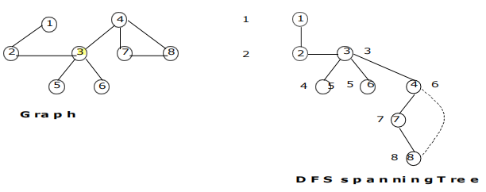
Example

Slide 21
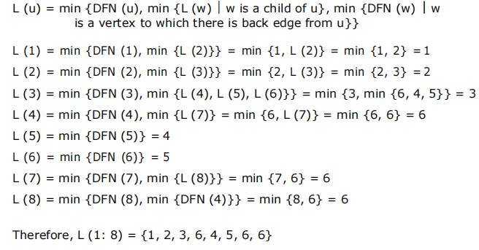
Biconnected Components

Slide 22
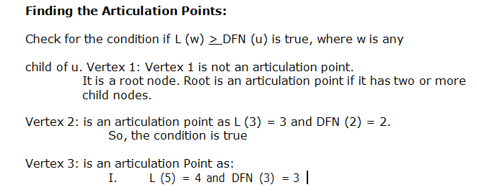
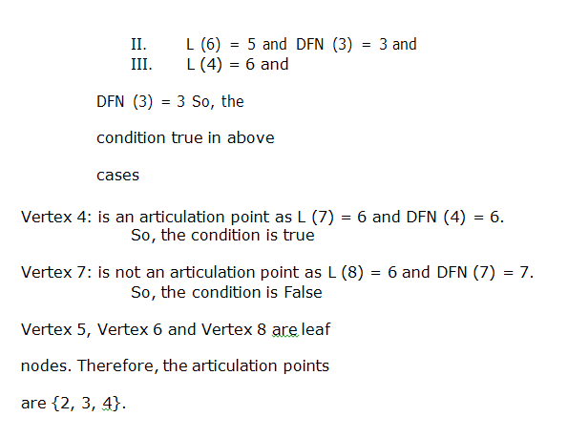

Slide 23
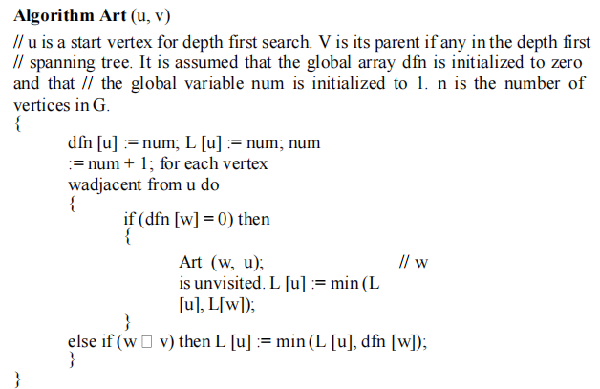
Algorithm for finding Articulation points

Slide 24
BACKTRACKING
Definition :
Backtracking is a technique based on algorithm to solve problem by using the recursive calls to find the solution by building a solution step by step increasing values with time.
It removes the solutions that doesn't give rise to the solution of the problem based on the constraints given to solve the problem.
we use the backtracking strategy to try out all the possible solutions.
Each decision leads to a new set of choices.

Slide 25
BACKTRACKING GENERAL METHOD
Algorithm Backtrack(x)
if x is not a solution return false
if x is a new solution
add to list of solutions
backtrack(expand x)

Slide 26
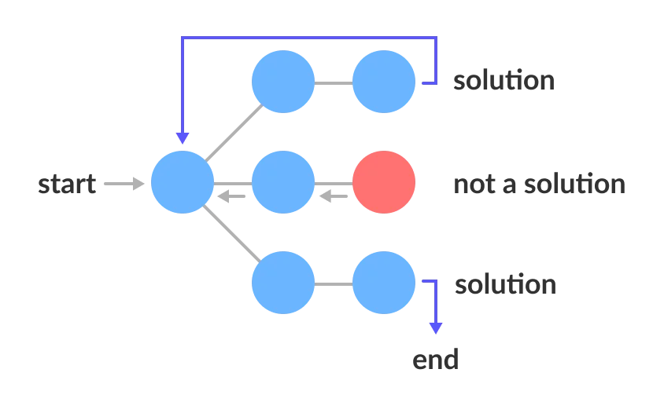
State Space Tree
A space state tree is a tree representing all the possible states (solution or non solution) of the problem from the root as an initial state to the leaf as a terminal state.

Slide 27
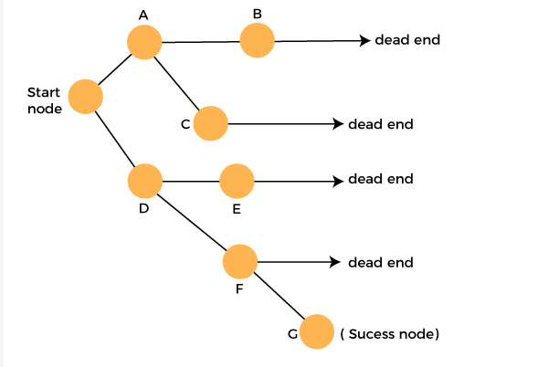
BACKTRACKING

Slide 28
BACKTRACKING
Terminology:
Problem state is each node in the depth first search tree.
Solution states are the problem states ‘S’ for which the path from the root node to ‘S’ defines a tuple in the solution space.
Live node is a node that has been generated but whose children have not yet been generated.
E-node is a live node whose children are currently being explored. In other words, an E node is a node currently being expanded.
Dead node is a generated node that is not to be expanded or explored any further. All children of a dead node have already been expanded.

Slide 29
BACKTRACKING
There are two types of constraints for solving a problem using Backtracking. Such
as,
Implicit constraint:
It is a rule in which how element in a tuple is related.
Explicit constraint:
The rules that restrict each element to be chosen from the given set.

Slide 30
BACKTRACKING
Applications:
N- Queen’s problem
Sum of subset problem
Graph coloring
Hamiltonian cycles

Slide 31
N-Queen’s problem
A classic combinational problem is to place n queens on a n*n chess board so that
no two attack, i.,e
1. No two queens are on the same row, column or diagonal.
2. If we take n=4 then the problem is called as 4 queen’s problem.
3. If we take n=8 then the problem is called as 8 queen’s problem.

Slide 32
4-Queen’s problem
Consider a 4*4 chessboard. Let there are 4 queens.
The objective is place the 4 queens on 4*4 chessboard in such a way that no two queens should be placed in the same row, same column or diagonal position.
The explicit constraints are 4 queens are to be placed on 4*4 chessboards in 44 ways.
The implicit constraints are no two queens are in the same row column or diagonal.
Let{x1, x2, x3, x4} be the solution vector where x1 column on which the queen i is placed.
First queen is placed in first row and first column.

Slide 33
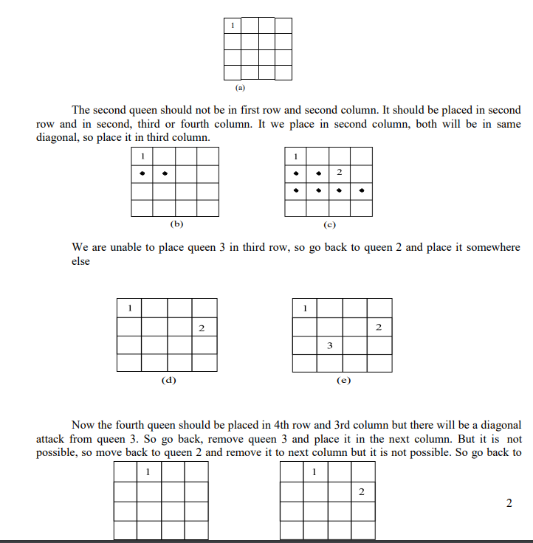

Slide 34
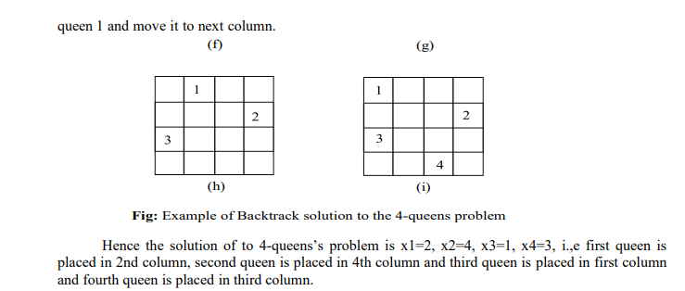

Slide 35
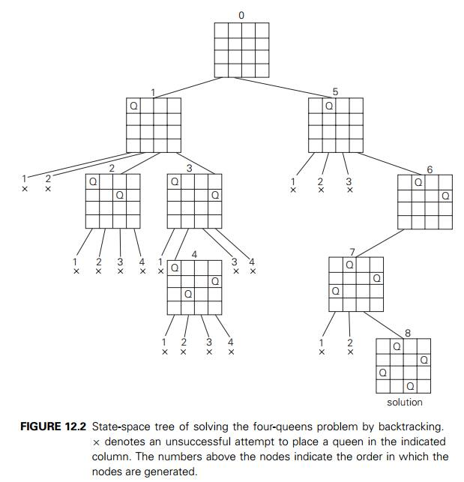

Slide 36
8-Queen’s problem
A classic combinatorial problem is to place 8 queens on a 8*8 chess board so that no two attack, i.,e no two queens are to the same row, column or diagonal.
Now, we will solve 8 queens problem by using similar procedure adapted for 4 queens problem.
The algorithm of 8 queens problem can be obtained by placing n=8, in N queens algorithm.
If two queens are placed at positions (i,j) and (k,l). They are on the same diagonal only if
i-j=k-l ……………….(1) or
i+j=k+l ……………….(2).
From (1) and (2) implies j-l=i-k and j-l=k-i
Two queens lie on the same diagonal iff |j-l|=|i-k|
The solution of 8 queens problem can be obtained similar to the solution of 4 queens problem.

Slide 37
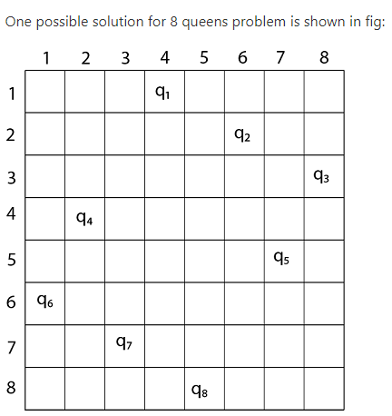
8-Queens problem
The solution can be shown as X1=3, X2=6, X3=2, X4=7, X5=1, X6=4, X7=8, X8=5

Slide 38
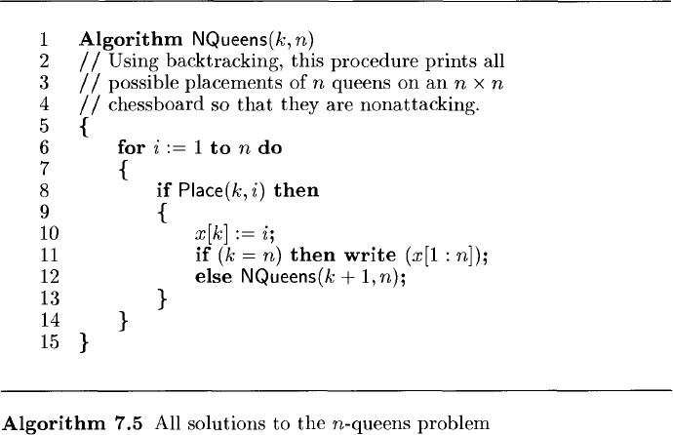
N-Queens problem

Slide 39
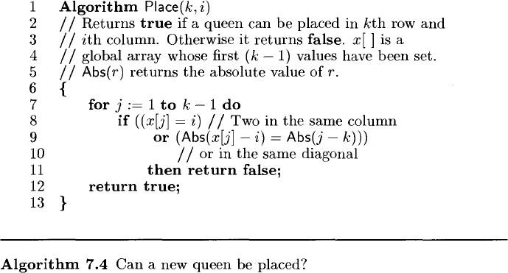
N-Queens problem

Slide 40
Sum of Subsets
Given positive numbers wi, 1 ≤ i ≤ n, and m, this problem requires finding all subsets of wi whose sums are ‘m’.
All solutions are k-tuples, 1 ≤ k ≤ n.
Explicit constraints: •
xi Є {j | j is an integer and 1 ≤ j ≤n}.
Implicit constraints: •
No two xi can be the same. •
The sum of the corresponding wi’s be m. •
xi < xi+1 , 1 ≤ i < k (total order in indices) to avoid generating multiple instances of the same subset (for example, (1, 2, 4) and (1, 4, 2) represent the same subset).

Slide 41
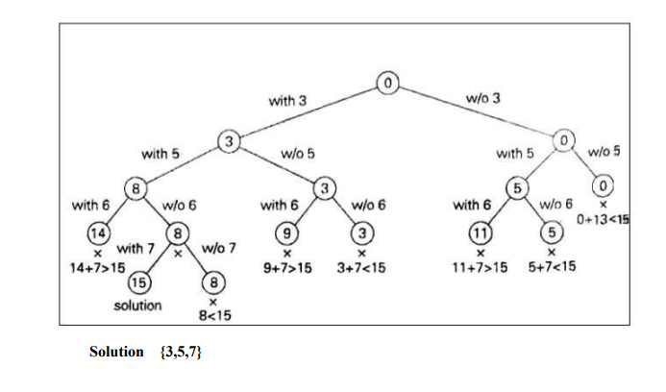
Sum of Subsets
Example: S = {3,5,6,7} and m = 15, Find the sum of subsets by using backtracking

Slide 42
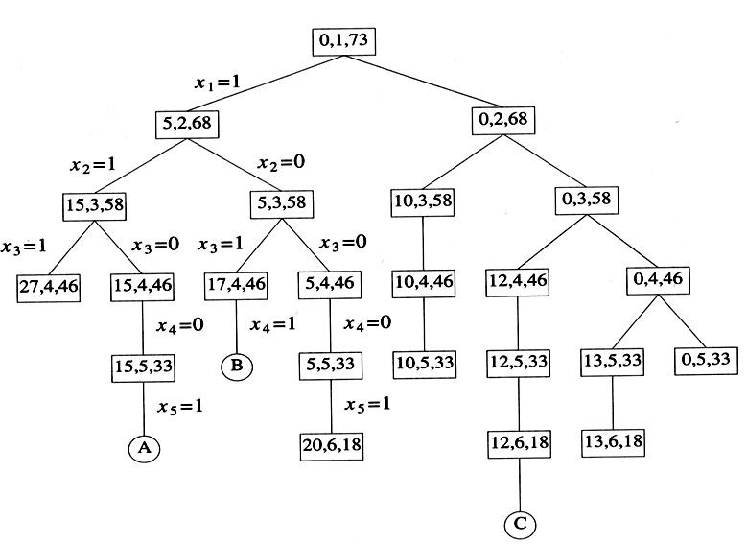
S={5, 10, 12, 13, 15, 18} and m=30

Slide 43
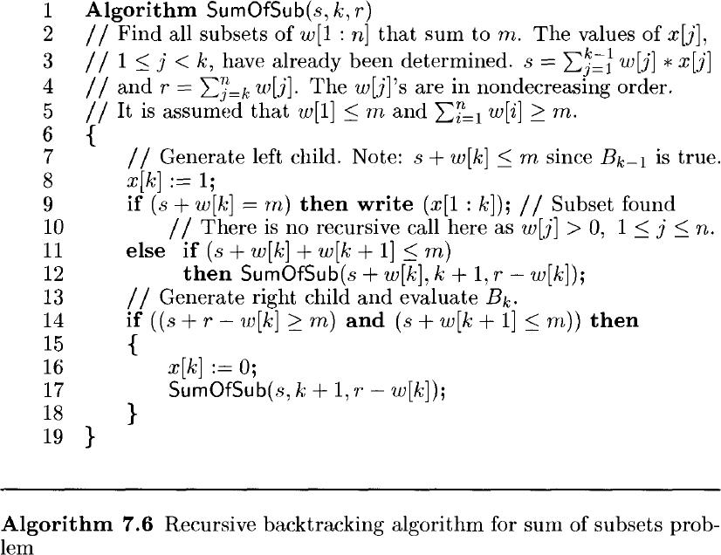
Sum of Subsets

Slide 44
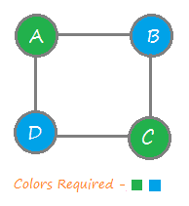
Graph coloring
Let G be a graph and m be a given positive integer.
We want to discover whether the nodes of G can be colored in such a way that no two adjacent nodes have the same color, yet only m colors are used.
This is termed the m-colorabiltiy decision problem.

Slide 45
Graph coloring
In this approach, we color a single vertex and then move to its adjacent (connected) vertex to color it with different color.
After coloring, we again move to another adjacent vertex that is uncolored and repeat the process until all vertices of the given graph are colored.
In case, we find a vertex that has all adjacent vertices colored and no color is left to make it color different, we backtrack and change the color of the last colored vertices and again proceed further.

Slide 46
Graph coloring
Steps To color graph using the Backtracking Algorithm:
Different colors:
Confirm whether it is valid to color the current vertex with the current color (by checking whether any of its adjacent vertices are colored with the same color).
If yes then color it and otherwise try a different color.
Check if all vertices are colored or not.
If not then move to the next adjacent uncolored vertex.
If no other color is available then backtrack (i.e. un-color last colored vertex).
Here backtracking means to stop further recursive calls on adjacent vertices by returning false. In this algorithm Step-1.(Continue) and Step-2 (backtracking) is causing the program to try different color option.
Continue – try a different color for current vertex. Backtrack – try a different color for last colored vertex.

Slide 47
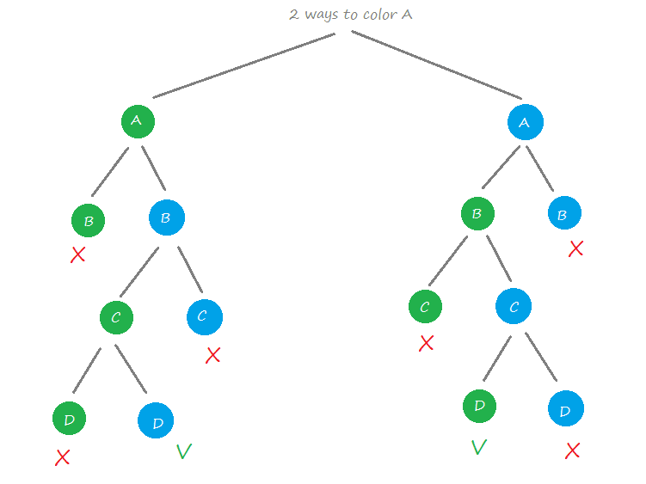
Graph coloring

Slide 48
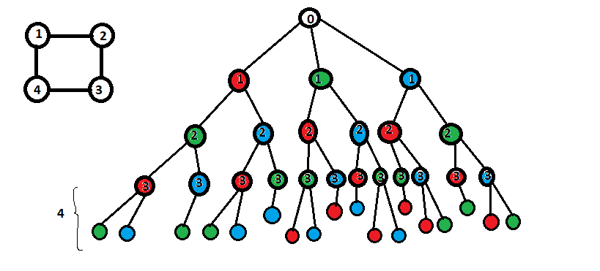
Graph coloring
Colors Given: Red, Green, Blue

Slide 49
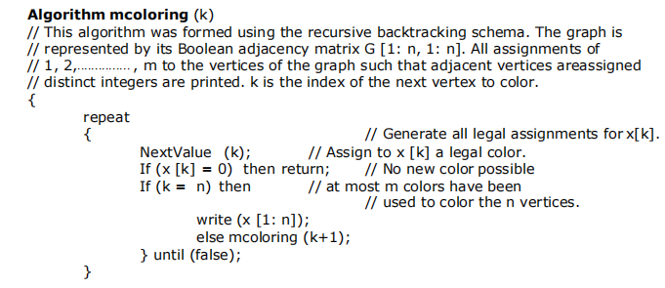
Graph coloring

Slide 50
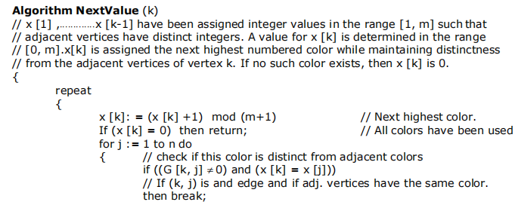

Graph coloring

Slide 51
Hamiltonian Circuits Problem
A Hamiltonian circuit or tour of a graph is a path that starts at a given vertex, visits each vertex in the graph exactly once, and ends at the starting vertex.
We use the Depth-First Search algorithm to traverse the graph until all the vertices have been visited.
We traverse the graph starting from a vertex (arbitrary vertex chosen as starting vertex) and at any point during the traversal we get stuck (i.e., all the neighbor vertices have been visited), we backtrack to find other paths (i.e., to visit another unvisited vertex).
If we successfully reach back to the starting vertex after visiting all the nodes, it means the graph has a Hamiltonian cycle otherwise not.
We mark each vertex as visited so that we don’t traverse them more than once.

Slide 52
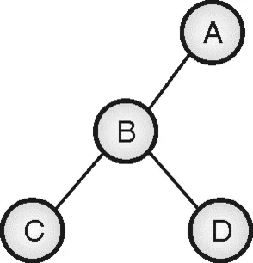
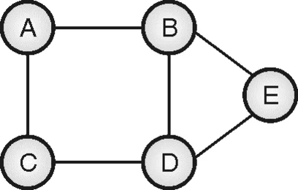
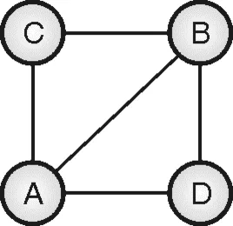
Hamiltonian Circuits Problem - Example

Slide 53
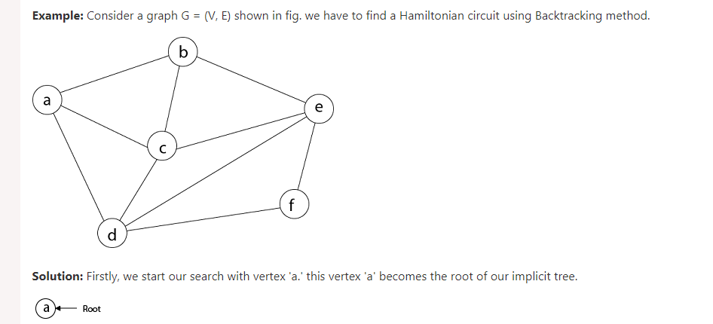
Hamiltonian Circuits Problem

Slide 54
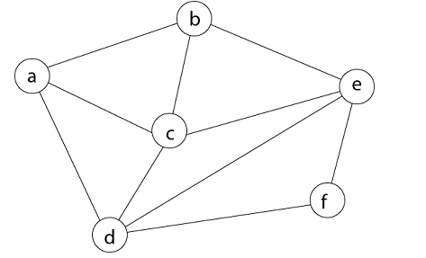
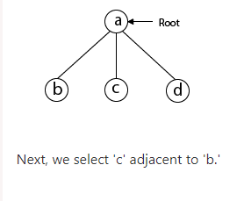
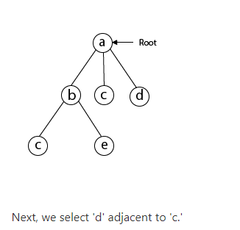
Hamiltonian Circuits Problem

Slide 55
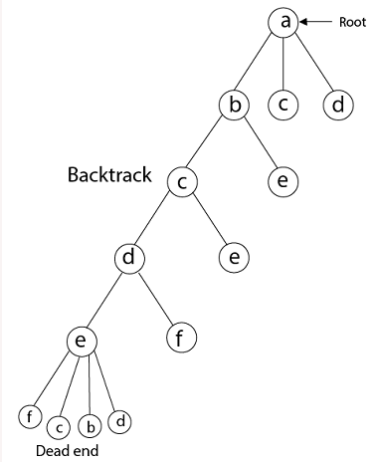
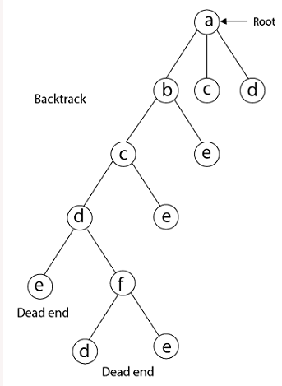
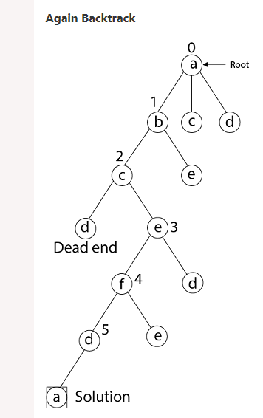
Hamiltonian Circuits Problem

Slide 56
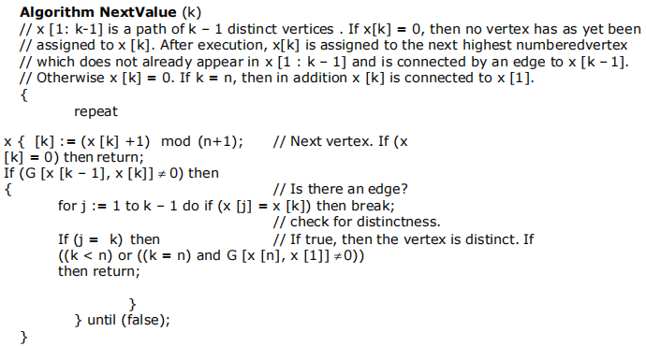
Hamiltonian Circuits Problem

Slide 57
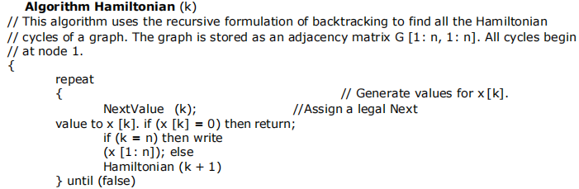
Hamiltonian Circuits Problem

